Slide 1
جامعة ديالى/كلية الهندسة
قسم الهندسة المدنية
تطبيقات حاسبة 1
المرحلة الثانية
البرمجة بلغة الفورتران
المحاضرة 8
إعداد:-
م.د.جنان لفته عباس
م.م. غسان منذر علي

Slide 2
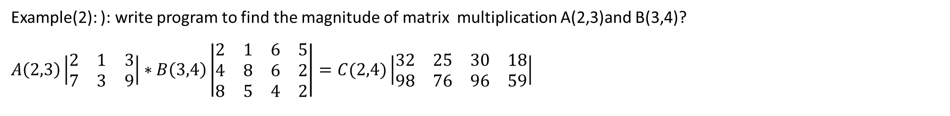
Example(2): ): write program to find the magnitude of matrix multiplication A(2,3)and B(3,4)?
$$A\left(2,3\right)\left|\begin{matrix}2 & 1 & 3 \\ 7 & 3 & 9\end{matrix}\right|∗B\left(3,4\right)\left|\begin{matrix}2 & 1 & 6 & 5 \\ 4 & 8 & 6 & 2 \\ 8 & 5 & 4 & 2\end{matrix}\right|=C(2,4)\left|\begin{matrix}32 & 25 & 30 & 18 \\ 98 & 76 & 96 & 59\end{matrix}\right|$$
Do I=1,2
Do J=1,4
C(I,J)=0
Do K=1,3
C(I,J)=C(I,J)+A(I,K)*B(K,I)
End Do
End Do
End Do
Do I=1,2
Print*,(C(I,J),J=1,4)
End Do
End program matrix
Solution:
Program matrix
Integer, Dimension(1:2,1:3)::A
Integer, Dimension(1:3,1:4)::B
Integer, Dimension(1:2,1:4)::C
Integer::I,J,K
Print*, “input the matrix A”
Read*,((A(I,J),J=1,3),I=1,2)
Print*, “input the matrix B”
Read*,((B(I,J),J=1,4),I=1,3)
Print*, “the matrix C”

Slide 3

Example(3): write a program to integrate two array A and B in array C as following?
A B C
$\left\{\begin{matrix}a1 \\ a2 \\ a3 \\ a4 \\ a5 \\ a6\end{matrix}\right\}$ $\left\{\begin{matrix}b1 \\ b2 \\ b3 \\ b4 \\ b5 \\ b6\end{matrix}\right\}$ $\left\{\begin{matrix}a1 \\ b1 \\ a2 \\ \begin{matrix}b2 \\ a3 \\ b3 \\ a4 \\ b4 \\ a5\end{matrix} \\ b5 \\ a6 \\ b6\end{matrix}\right\}$

Slide 4
Solution:
Program Q3
Implicit none
Real, Dimension(1:6)::A
Real, Dimension(1:6)::B
Real, Dimension(1:12)::C
Integer:: I,J,K,L,M
Do I=1,6
Print*,”input A”
Read*,A(I)
End Do
Do J=1,6
Print*,”input B”
Read*,B(J)
End Do
L=0
Do K=1,12,2
L=L+1
C(K)=A(L)
C(K+1)=B(L)
End Do
Do M=1,12
Print*,”C(M)=”,C(M)
End Do
End program Q3

Slide 5
Example(4): write program to print student name and his average foe six marks after reading the name for each students and his degrees to eight students?
Solution:
Program Q4
Implicit none
Real, Dimension (1:6)::M
Character(Len=9), Dimension(1:8)::A$
Real, Dimension (1:8)::average
Real::Sum
Integer::I,J
Do I=1,8
Sum =0
Print*,”input A$”
Read*,M(J)
Sum =Sum +M(J)
End Do
Average (I)=Sum/6
Print*,”A$(I)=”,A$(I)
Print*,”Average(I)=”,Average(I)
End Do
End program Q4

Slide 6
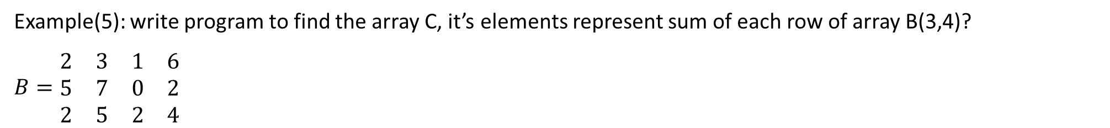
Example(5): write program to find the array C, it’s elements represent sum of each row of array B(3,4)?
$$B=\begin{matrix}2 & 3 & 1 & 6 \\ 5 & 7 & 0 & 2 \\ 2 & 5 & 2 & 4\end{matrix}$$
Solution:
Program Q5
Implicit none
Integer, Dimension(1:3,1:4)::B
Integer, Dimension(1:3)::C
Integer::I,J,K
Print*,”input the matrix B”
Read*,((B(I,J),J=1:4),I=1,3)
Do I=1,3
C(I)=0
Do J=1,4
C(I)=C(I)+B(I,J)
End Do
End Do
Do K=1,3
Print*,”C(K)=”,C(K)
End Do
End program Q5

Slide 7
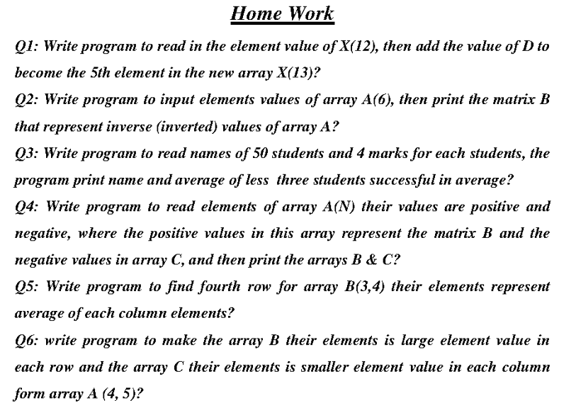

Slide 8
شكرا لأصغائكم

